Slide 1
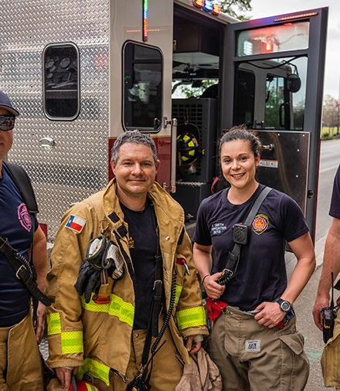
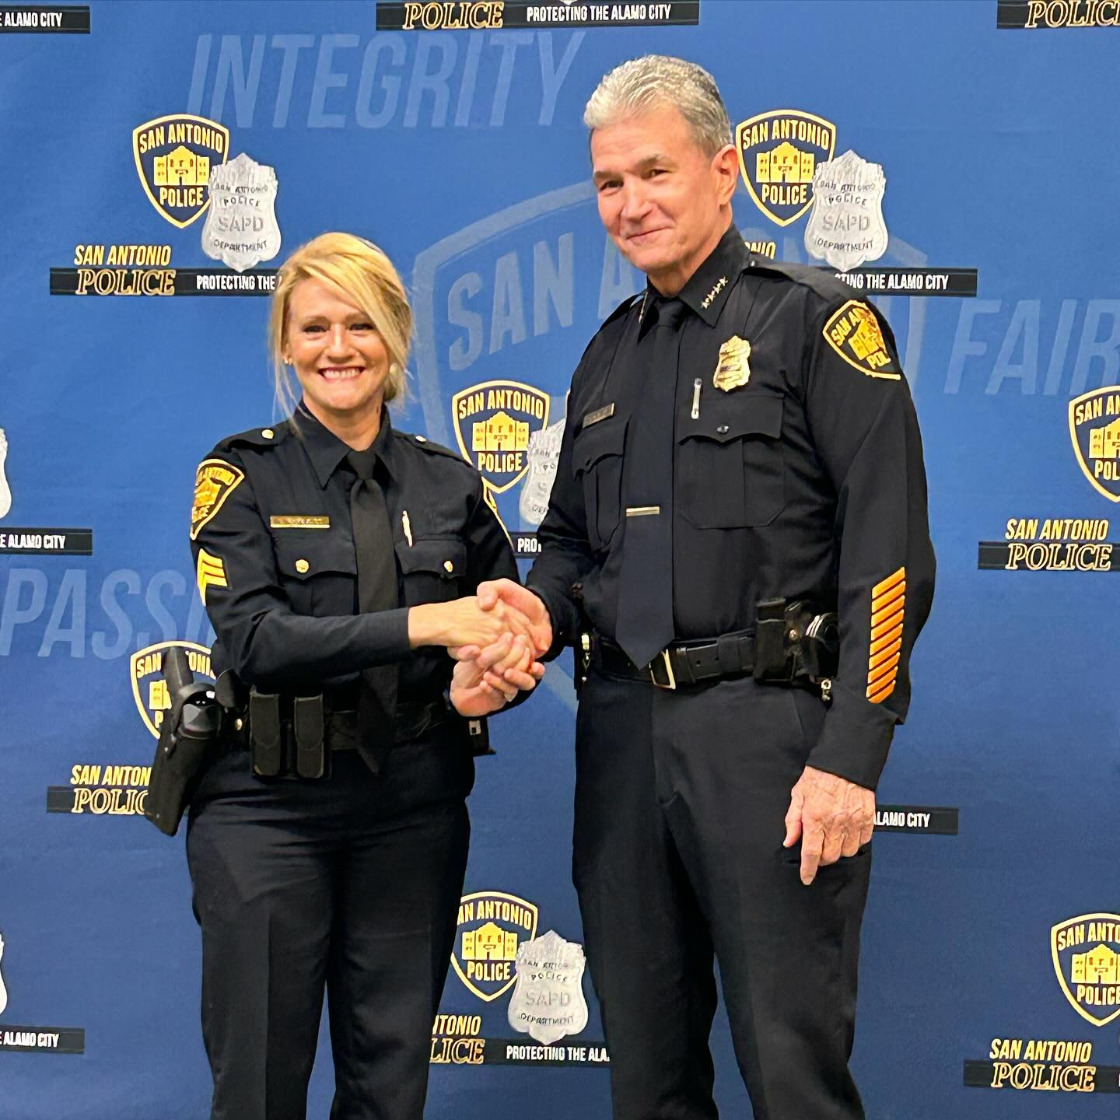
How to talk to People in Uniform Fire Department / Emergency Medical Services
San Antonio Fire Department
Dana Williams – Firefighter / Paramedic
Eddie Flores – Firefighter / EMT

Slide 2


Agenda for today
Classroom Presentation
Questions and Answers
Ambulance tour/walk through and medical equipment
Practice introducing yourself

Slide 3

How can you identify a First Responder?

Slide 4
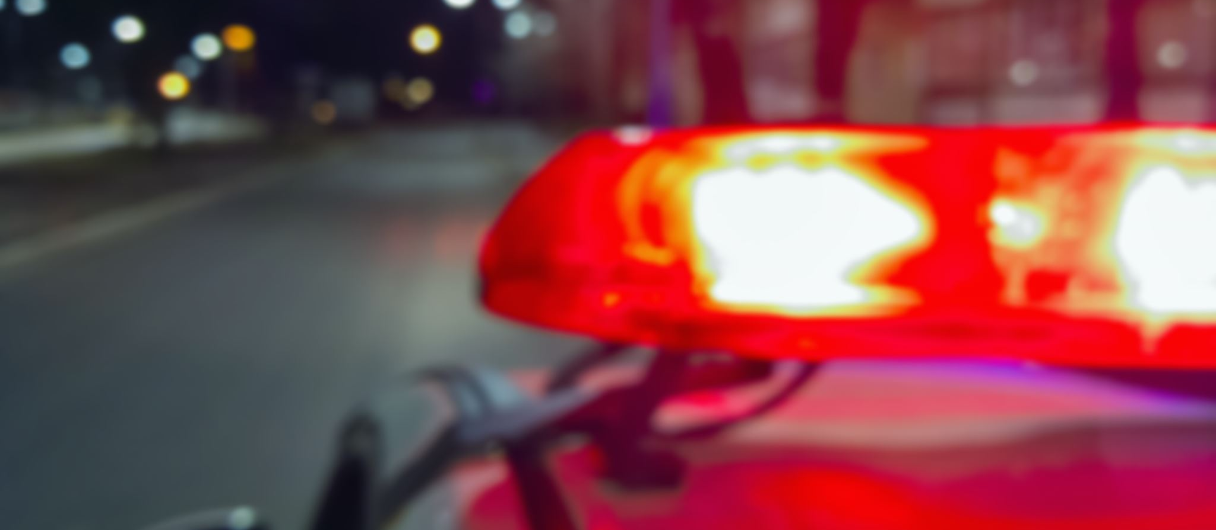
First responders will have the following:
Uniforms and Badges: Uniforms often feature patches, badges, and embroidered names specifying the agency (e.g., "Police," "Fire," "EMS").
Uniform Colors/Symbols: Distinct colors are often used, such as blue for police, white or red for fire, and sometimes specialized badges.
High-Visibility Gear: Hi-visibility vests, armbands, or helmet stickers are common for on-scene identification.
Vehicle Identification: Emergency vehicles (fire trucks, ambulances, police cruisers) will have official department markings, flashing lights, and sirens.

Slide 5
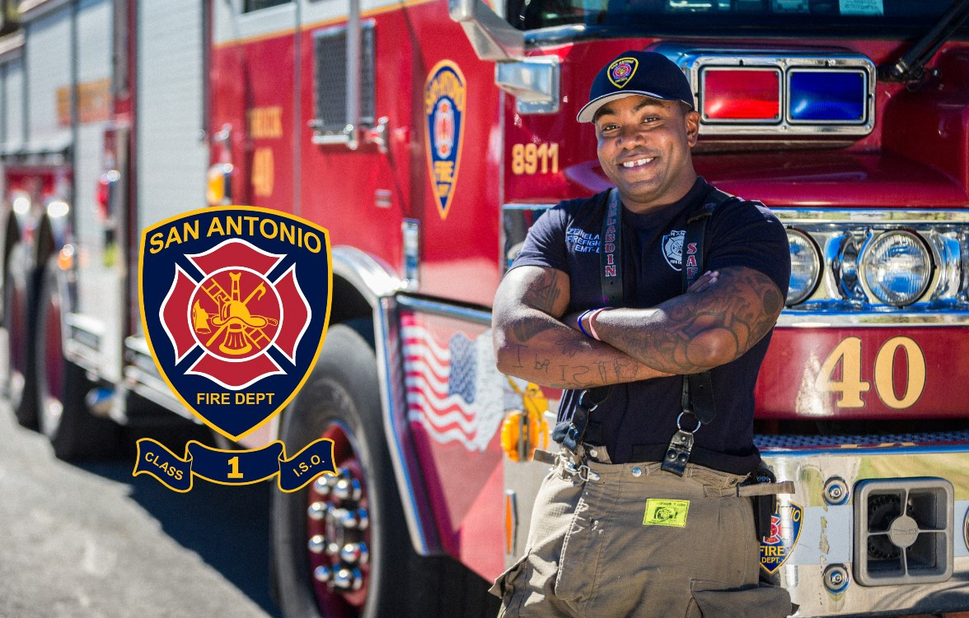
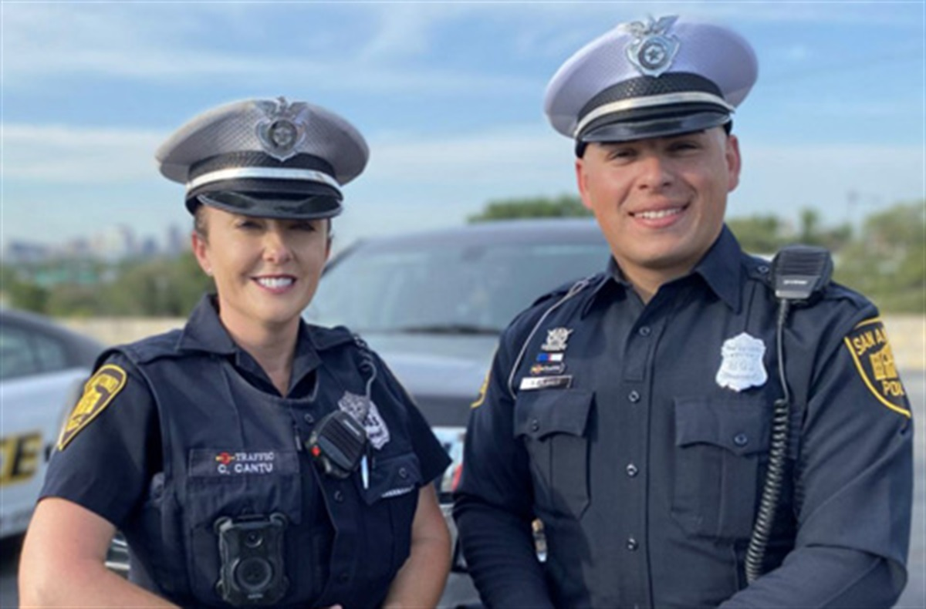

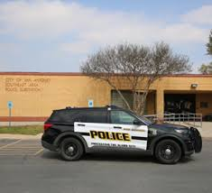
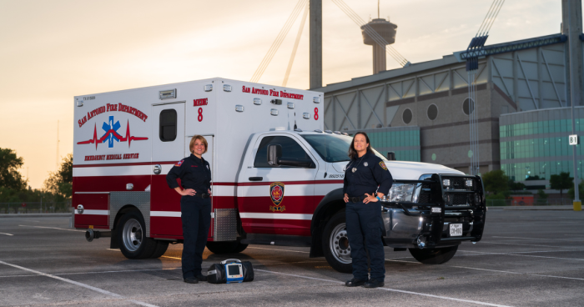
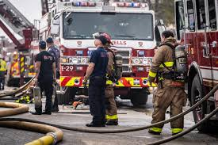

Slide 6
Approaching a First responder (Hearing and Verbal)
Be Calm and Clear: Speak in a normal tone, avoiding screaming or acting frantically, as this helps them process information faster.
Slow Down: Allow extra time for them to respond to you, especially if they are managing a high-stress scene
Physical Distance: Do not crowd them. Approach in a way that is not threatening, keeping your hands visible.
Provide Key Info: Immediately state what is happening, where it is happening, and if anyone is in immediate danger
6

Slide 7
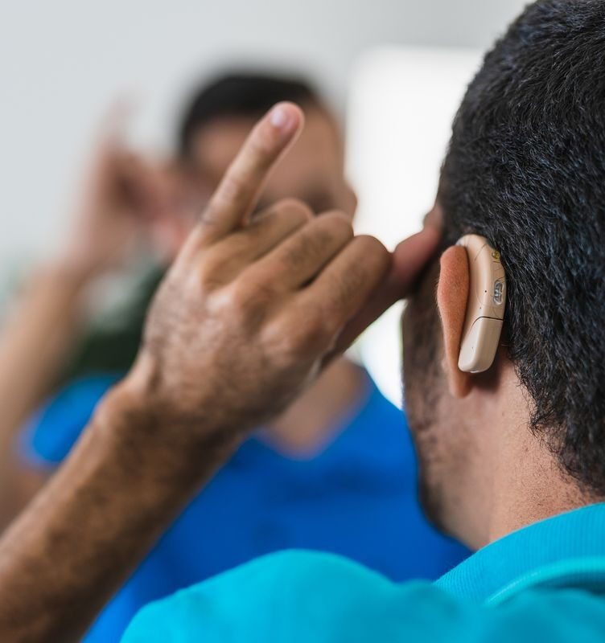
Approaching a 1st Responder (Person with hearing loss)
Get Attention: Gently tap their shoulder or wave. Use lights, such as turning room lights on/off, to grab attention.
Establish Communication: Point to your ear and shake your head, or point to your mouth/ear to signal being hard of hearing.
Face-to-Face: Ensure your face is visible, well-lit, and unobstructed (no masks or chewing gum) so the responder can read your lips and see facial expressions.
Use Written Notes: Use a smartphone note app, paper and pen, or a whiteboard to write messages.
Keep it Simple: Use clear, simple gestures to explain the emergency.
Request an Interpreter: If the situation is complex, ask for a qualified sign language interpreter. Under the ADA, they are required to provide effective communication, including interpreters.
7

Slide 8
Approaching a 1st Responder (Non-verbal)
Use Visual Tools: Use your phone or tablet to text, write in a note-taking app, or display a pre-written message explaining your situation.
Show Identification: Immediately point to a medical alert bracelet, wallet card, or a document stating you are non-verbal.
Slow Down and Signal: Make non-threatening movements. Raise hands to show you are unarmed, then use simple hand gestures to show you need help, such as pointing to your throat, head, or a pain point.
Use Written Notes: Carry a small notebook to write down crucial information like "I am safe," "I need help," or your address.
Use Picture Cards: If available, point to pictures (e.g., pain, water, toilet) to communicate, as recommended by FEMA.
8

Slide 9

How to visually identify your needs to a 1st Responder
Wear a medical identification device, such as a bracelet or necklace.
Use an identifying sticker inside your home or inside your vehicle.
Use dedicated phone lock-screen graphics with a special needs alert icon.

Slide 10
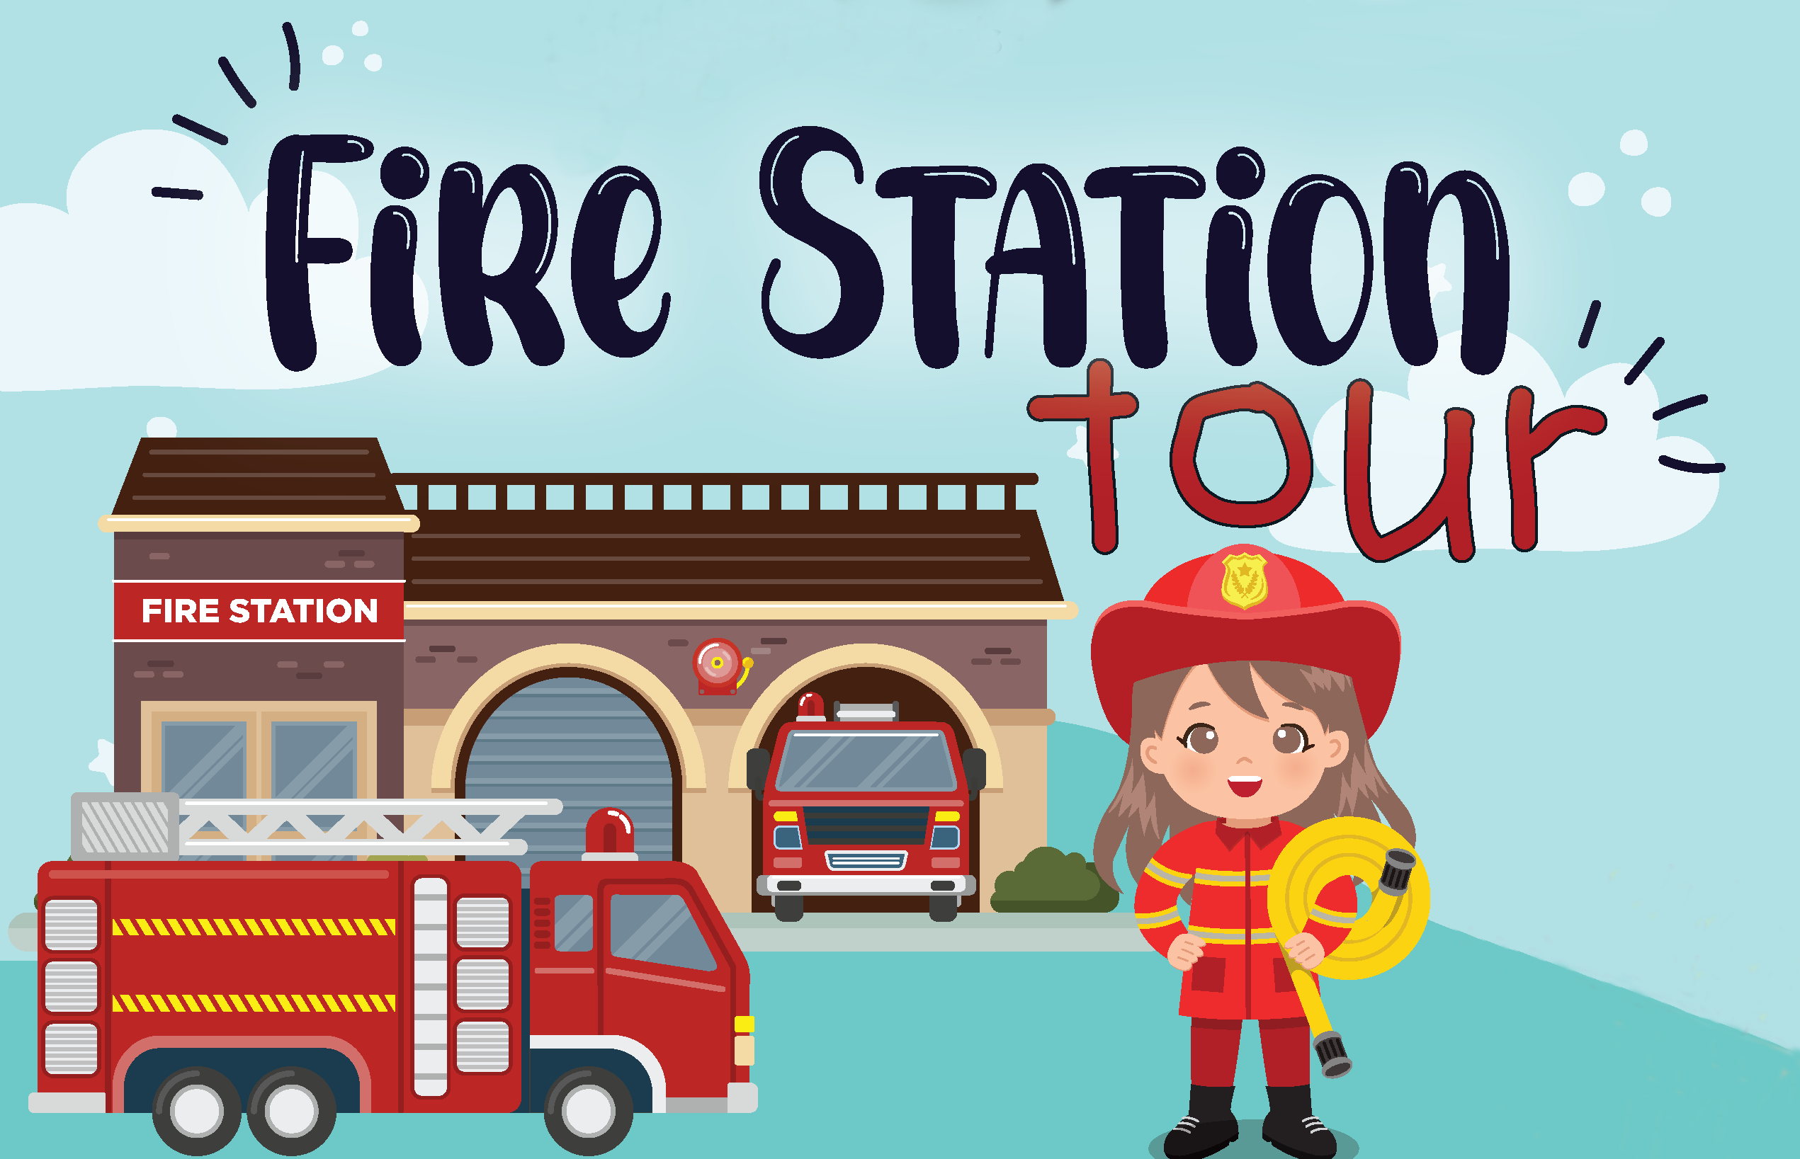
Get to know your local 1st Responders
Visit your local Fire Station / EMS
Visit your local Police Station
Attend events 1st Responders will also be attending.

Slide 11
Prepare for Emergencies before they happen.
Prepare a GO BAG / KIT (3 days worth of clothes, non-perishable food, and medication).
Make copies of I.D.s / passports / birth certificates.
Make copies of important medical information / fill out a File of Life form.
Wear a medical bracelet / necklace.
Create an escape / evacuation plan with a backup or alternative option.
Carry a communication device (telephone, tablet, picture cards).
Install smoke alarms / bed shakers / strobes (SAFD has a free program! – (FireSafeSA.com for sign up) Install Carbon Monoxide Detector.
**please get pre-made packets after the presentation**

Slide 12

Important Safety Websites
https://www.firesafesa.com/
State of Texas Emergency Assistance Registry
Alerts - City of San Antonio
Emergency Evacuation Guide for People with Disabilities PDF.
Fire Safety for People with Disabilities
Fire Prevention 52: Fire Safety for People with Disabilities (U.S. National Park Service)
12

Slide 13

Thank you!!!!
Questions?
Dana Williams
Disability Program Coordinator
Dana.Williams@sanantonio.gov
Firesafesa.com

